Slide 1
WEB APPLICATION
ARCHITECHTURE

Slide 2
Agenda:
Web Application
Server-side code - Client-side code
TCP/IP Model
HTTP
HTTP Request
HTTP Response
HTTP Cache
DNS
DNS Cache
FTP

Slide 3
Web Application:
A web application is any computer program that performs a specific function by using a web browser as its client.

Slide 4
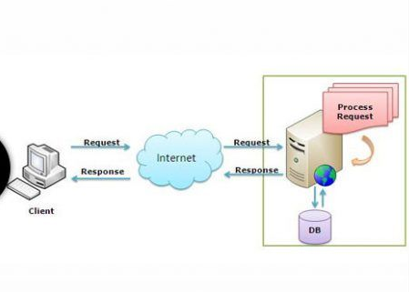
Web Application Architecture:
There are basically two programs in web application running at the same time:
responds to requests(Server-side/Back-End).
responds to user input(Client-side/Front-End).

Slide 5
Server-Side Code
Languages/frameworks include but are not limited to Ruby (Rails), Javascript (Node.js), Python (Django), PHP, C#, and Java;
Client-Side Code
Languages used include: HTML, CSS, and Javascript.

Slide 6
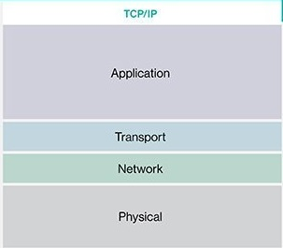
TCP/IP Model:
Application layer is the top most layer of four layer TCP/IP model.
Application layer includes all the higher-level protocols DNS (Domain Naming System), HTTP (Hypertext Transfer Protocol), Telnet, FTP (File Transfer Protocol), SMTP (Simple Mail Transfer Protocol) ,
The transport layer is responsible for end-to-end communications across the network.
Allow hosts to insert packets into any network and have them to deliver independently to the destination.
Physical connection between the computer and the network medium

Slide 7
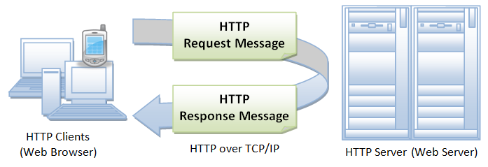
HTTP
The Hypertext Transfer Protocol (HTTP) is designed to enable communications between clients and servers.
A client (browser) submits an HTTP request to the server; then the server returns a response to the client.
The response contains status information about the request and may also contain the requested content.

Slide 8
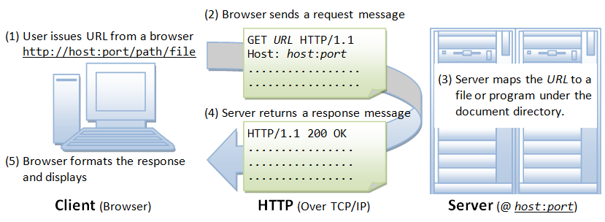
HTTP Process:
A URL (Uniform Resource Locator) : Uniquely identify a resource over the web.
Syntax:
protocol://hostname:port/path-and-file-name
Protocol: The application-level protocol used by the client and server, e.g., HTTP, FTP.
Hostname: The DNS domain name (e.g., www.nowhere123.com) or IP address (e.g., 192.128.1.2) of the server.
Port: The TCP port number that the server is listening for incoming requests from the clients.
Path-and-file-name: The name and location of the requested resource, under the server document base directory.

Slide 9
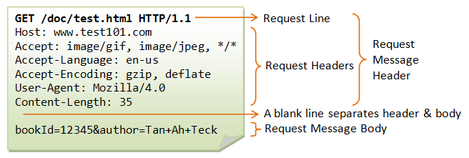
HTTP REQUEST:
Example:
The following shows a sample HTTP request message:

Slide 10
HTTP REQUEST METHODS:
GET
A client can use the GET request to get a web resource from the server.
HEAD
The HEAD method asks for a response identical to that of a GET request, but without the response body.
POST
Used to post data up to the web server.
PUT
Ask the server to store the data..

Slide 11
OPTIONS
The OPTIONS method to query the server which request methods are supported.
DELETE
The DELETE method deletes the specified resource.
TRACE
Ask the server to return a diagnostic trace of the actions it takes.

Slide 12
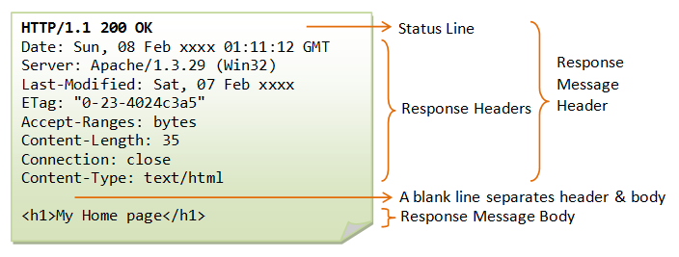
HTTP RESPONSE:
An example of the HTTP response message is as shown:

Slide 13
HTTP response status codes
200 OK
300 Multiple Choices
301 Moved Permanently
400 Bad Request
401 Unauthorized
403 Forbidden
404 Not Found
407 Proxy Authentication Required
417 Expectation Failed
500 Internal Server Error
501 Not Implemented
502 Bad Gateway
503 Service Unavailable

Slide 14
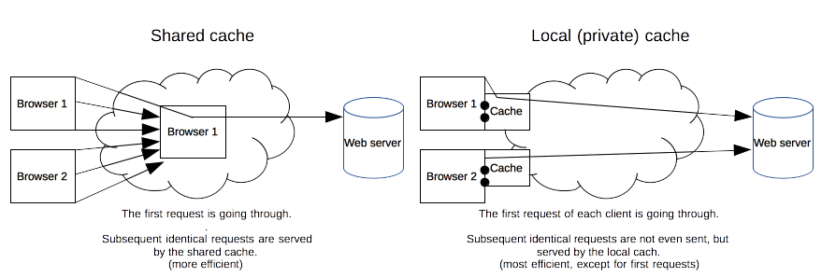
HTTP CACHE :
Private cache- A private cache is dedicated to a single user
Shared cache- A shared cache is a cache that stores responses for reuse by more than one user

Slide 15
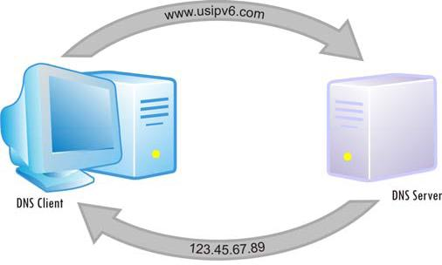
DNS:
The domain name system (or) Server (DNS) is the way that internet domain names are located and translated into internet protocol (IP) addresses
DNS Cache :
A DNS cache (sometimes called a DNS resolver cache) is a temporary database, maintained by a computer's operating system.
It contains records of all the recent visits and attempted visits to websites and other internet domains.

Slide 16
FTP
File Transfer Protocol (FTP) is the commonly used protocol for exchanging files over the Internet. FTP uses the Internet's TCP/IP protocols to enable data transfer.
FTP is most commonly used to download a file from a server using the Internet or to upload a file to a server

Slide 17
End of Presentation.
Thank you for listening.
Any suggestions or comments?

